Slide 1
6.1: Creating and Using Arrays

Slide 2
Arrays - Declaration
An Array variable is is a collection of values of the same type and is declared like this
type[] name;
boolean[] answers; String[] questions; int[] scores; Student[] students;
Note: Arrays in Java are Object types. As-written - these Array variables are undefined and your code will fail if you attempt to access them.
So...

Slide 3
Arrays - Creation
Note 1: Each of these Array variables now have a value assigned to them - And can be referenced by your code.
Note 2: After creation every Array has an available length property (which never changes)
Arrays are created with an initializer list or new
boolean[] answers = {true, false, false, true}; int[] scores = {100, 84, 95, 78}; double[] prices = new double[20]; String[] questions = new String[5]; int numStudents = 10; Student[] students = new Student[numStudents];

Slide 4
Arrays - Creation
boolean[] answers = {true, false, false, true};
int[] scores = {100, 84, 95, 78};
booleans
answers
true
false
false
true
0
1
2
3
answers.length: 4
ints
scores
100
84
95
78
0
1
2
3
scores.length: 4

Slide 5
Arrays - Creation - Primitive Defaults
boolean[] answers = new boolean[4];
int[] scores = new int[4];
booleans
answers
false
false
false
false
0
1
2
3
answers.length: 4
ints
scores
0
0
0
0
0
1
2
3
scores.length: 4

Slide 6
Arrays - Creation
Using new to re-assign an Array is allowed
boolean[] answers = {true, false, false, true};
This works!
answers = new boolean[4];
This also works...
answers = new boolean[] { true, false, false, true };

Slide 7
Arrays - Access - length
The length of an Array can be determined via the length property. Note: The length of a String is accessed via the String.length() method.
boolean[] answers = {true, false, false, true}; System.out.println(answers.length); A> 4 String[] questions = new String[5]; System.out.println(questions.length); B> 5

Slide 8
Arrays - Access - READING
Items in an Array can be read via the [index] property. Note: Like String - index is zero-based and the range of valid index values is 0 to length-1
boolean[] answers = {true, false, false, true}; System.out.print(answers[2] + ", " + answers[0]); C> false, true int[] scores = {100, 84, 95, 78}; System.out.print(scores[1] + ", " + scores[3]); D> 84, 78
Note: Passing an out of range index will cause a ArrayIndexOutOfBoundsException!

Slide 9
Arrays - Access - WRITING
Items in an Array can be written via the [index] property. Note: Unlike String - you can change the values in an Array after it is created (however you cannot change its length after creation)
boolean[] answers = {true, false, false, true}; answers[2] = true; answers[0] = false; System.out.print(answers[2] + ", " + answers[0]); C> true, false int[] scores = {100, 84, 95, 78}; scores[1] = 48; scores[3] = 87; System.out.print(scores[1] + ", " + scores[3]); D> 84, 87

Slide 10
Arrays - Access - Object Types
Arrays that hold Object types work a little differently than those that hold primitive types
We already saw that the length properly works String[] questions = new String[5]; System.out.println(questions.length); B> 5
But what about reading and writing values in an Array that holds Object types? System.out.println(questions[1]); E> ?

Slide 11
Arrays - Access - Object Types
Arrays that hold Object types work a little differently than those that hold primitive types
We already saw that the length properly works String[] questions = new String[5]; System.out.println(questions.length); B> 5
But what about reading and writing values in an Array that holds Object types?

Slide 12
Arrays - Access - Object Types
But what about reading and writing values in an Array that holds Object types? String[] questions = new String[5]; System.out.println(questions[1]); E> null
Student[] students = new Student[10]; System.out.println(students[1]); F> null
For Arrays that hold Object types - each slot will be be initialized to null
Initialize each Array slot with new
students[0] = new Student();
students[1] = new Student();
students[2] = new Student();
...

Slide 13
Arrays - Creation
String[] questions = new String[5];
Student[] students = new Student[10];
Strings
questions
null
null
null
null
null
0
1
2
3
4
questions.length: 5
Students
students
null
null
null
null
null
null
null
null
null
null
0
1
2
3
4
5
6
7
8
9
students.length: 10

Slide 14
Arrays - Creation
String[] questions = new String[5];
Student[] students = new Student[10];
Strings
questions
null
null
null
null
null
0
1
2
3
4
questions.length: 5
Students
students
null
null
null
null
null
null
null
null
null
0
1
2
3
4
5
6
7
8
9
students.length: 10
students[0] = new Student();
Student

Slide 15
6.2: Traversing Arrays with
for loops

Slide 16
Traversing Arrays with for loops
Evaluate initialization expression
Now we can now combine this with what we have learned about accessing Arrays
Arrays have a property called length and elements can be access via [] and an index
Does condition evaluate to true?
Yes
for (initialization; condition; increment)
statement
No
Execute body statement
Example:
int[] scores = {95, 100, 91, 85 };
for (int idx = 0; idx < scores.length; idx++) {
System.out.println(scores[idx]);
}
Evaluate increment expression
Next statement after for

Slide 17

Traversing Arrays with for loops
Remember that the range of valid Array indexes (for non-empty Arrays) is 0 to Array.length - 1
int[] scores = {95, 100, 91, 85 };
for (int idx = 0; idx < scores.length; idx++) {
System.out.println(scores[idx]);
}
This loop also skips the first element in the Array!
int[] scores = {95, 100, 91, 85 };
for (int idx = 1; idx <= scores.length; idx++) {
System.out.println(scores[idx]);
}
Note: Passing an out of range index will cause a ArrayIndexOutOfBoundsException!

Slide 18
Traversing Arrays with for loops
You can use a for loop to traverse an Array from back to front!
int[] scores = {95, 100, 91, 85 };
for (int idx = scores.length - 1; idx >= 0; idx--) {
System.out.println(scores[idx]);
}

Slide 19
Traversing Arrays with for loops
You can use a for loop to traverse an Array from back to front!
int[] scores = {95, 100, 91, 85 };
for (int idx = scores.length - 1; idx >= 0; idx--) {
System.out.println(scores[idx]);
}
...or to traverse any arbitrary range of elements
int[] scores = {95, 100, 91, 85 };
for (int idx = 1; idx <= 2; idx++) {
System.out.println(scores[idx]);
}

Slide 20
6.3: Traversing Arrays with
for-each loops

Slide 21
Traversing Arrays with for-each loops
An alternate way to loop through Objects that support the Iterable interface
for (type arrayItemVariable : arrayVariable) { arrayItemVariable is a copy of arrayVariable[0] arrayItemVariable is a copy of arrayVariable[1] arrayItemVariable is a copy of arrayVariable[...] arrayItemVariable is a copy of arrayVariable[arrayVariable.length-1] then the loop terminates }

Slide 22
Traversing Arrays with for-each loops
for (type arrayItemVariable : arrayVariable) { arrayItemVariable resolves to arrayVariable[...] }
String[] colors = {"red", "orange", "purple"}; System.out.println("begin"); for(String color: colors){ System.out.println(" " + color); } System.out.println("end");
Output:
begin
red
orange
purple end

Slide 23

Traversing Arrays with for-each loops
The type of the for-each variable MUST match the type of the values stored in the Array
String[] colors = {"red", "orange", "purple"}; for(int color: colors){ System.out.println(" " + color); }
Note: color must be of type String since colors is an Array that contains Strings

Slide 24
Comparing for and for-each loops
for
Direct access to any element in the Array - in any order - using zero-based index and []
You always know the index - so using parallel Arrays is easy!
May require more variables to efficiently operate
Can change the value of an Array element during the loop
for-each
Sequential access to the elements in the Array - must always go from first to last
You do not know the index - so using Parallel Arrays is harder (impossible?)
May eliminate the need for extra variables (no need to use indexes to access an item)
Cannot change the value of an Array element during the loop

Slide 25
6.4: Array Algorithms
part 1

Slide 26
Minimum and Maximum Value
These require a "tracking value" for the smallest or largest value found so far.
25 | 70 | 9 | 3 | 15 | 16 | 19
minV =
25
25
9
3
3
3
3

Slide 27
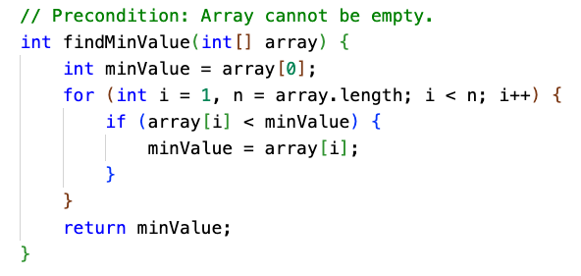
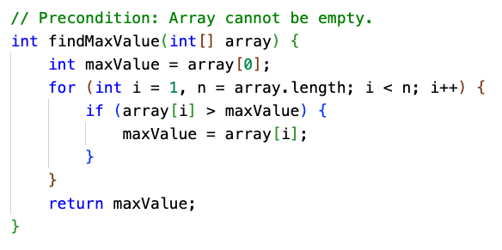
Minimum and Maximum Value
One trick is to "seed" the tracking value with the first element, and skip it in the loop.

Slide 28
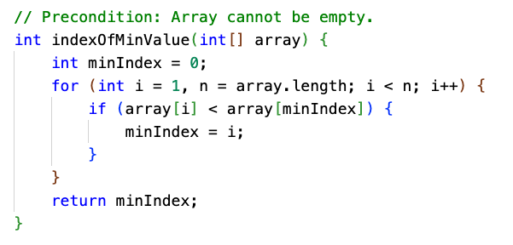
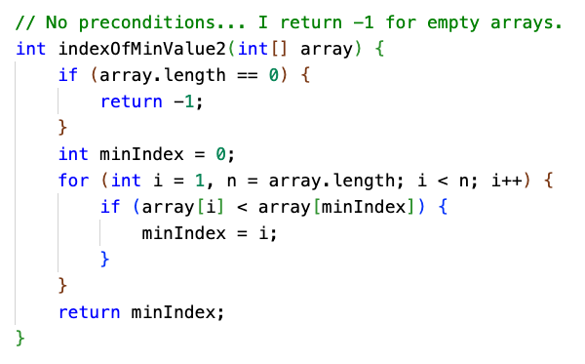
Minimum and Maximum Value
With a little modification, you could return the array index instead of the value.

Slide 29
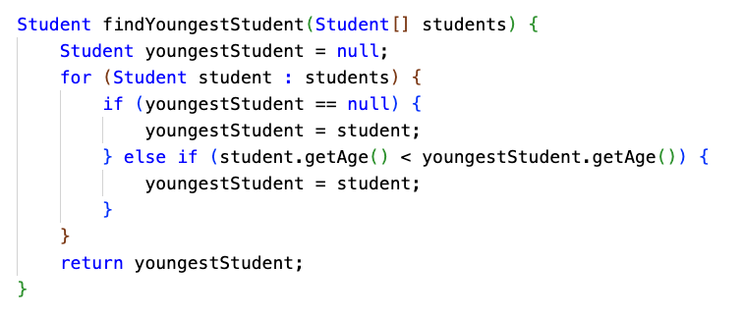
Minimum and Maximum Value of Objects
You might be dealing with an array of something other than numbers.

Slide 30
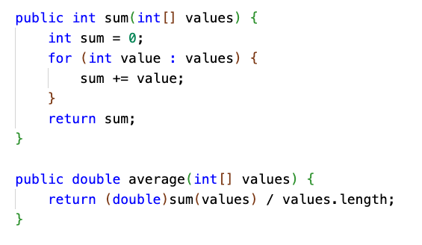
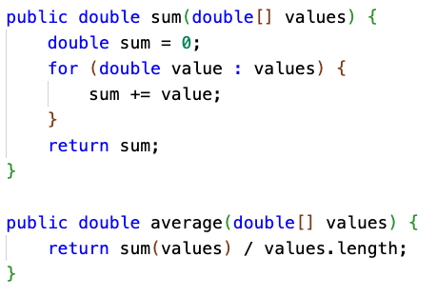
Sum and Average
If dealing with ints, remember to cast to double when calculating average. (Also known as the arithmetic mean.)

Slide 31
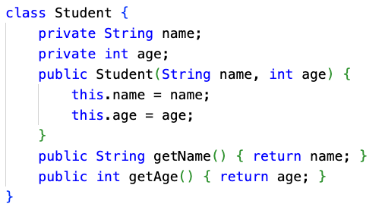
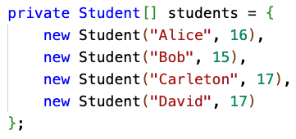
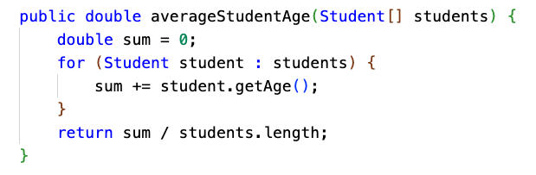
Calculations aren't always over int[] or double[]...
What if you are calculating the average age of a class of Students?

Slide 32
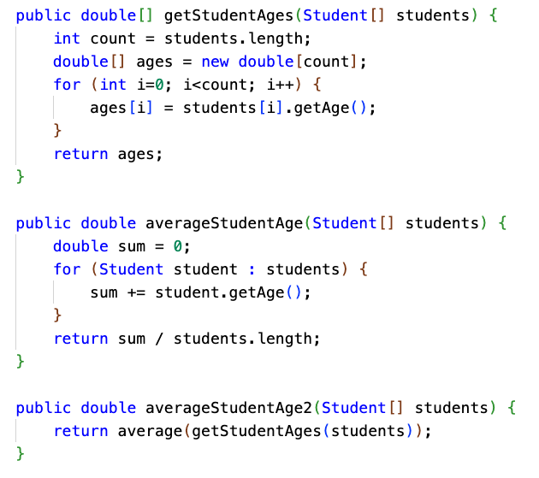
Transforming arrays to do calculations
It can make sense to transform an Array into another Array, and then do a calculation.
Creating the ages Array takes time and memory... but it can make sense, depending on the situation.
The age data might be used more than once
You might be interfacing with code, such as a third-party library, that doesn't know about Students
Your math-heavy code stays in its "domain" ... it only needs to know about math, not Students, and can be reused for things other than Students.
Performance and memory usage may not be critical

Slide 33
Median
Median is defined as the "middle element" of an array.
The array needs to be sorted for it to work.
If the array has odd length, the element in the middle is returned.
If the array is of even length, there isn't a "middle" ... so return the mathematical average of the two elements in the middle.
1 | 3 | 7 | 9 | 15 | 16 | 19
1 | 3 | 7 | 9 | 15 | 16 | 19 | 23

Slide 34
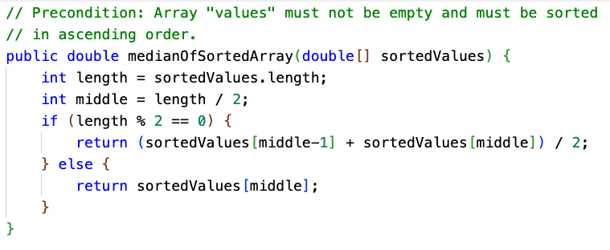
Median
The array needs to be sorted. We could declare a precondition!
We also declare a precondition that the input array must not be empty.

Slide 35

Median Student Age
Suppose we have an array of Students again. How do we calculate the median age?
We're able to use the tools we already built to get the student ages, and calculate the median of an array of numbers.
This is the power of composing methods together, and having general-purpose methods that can be applied in multiple situations. Breaking big problems into smaller problems is what CS is all about.

Slide 36
Mode
The mode of an array is the value that occurs most frequently.
What is the mode of this array?
17 | 17 | 9 | 9 | 9 | 9 | 1 | 17 | 19 | 3 | 3 | 5

Slide 37
Mode
We can calculate the mode using a nested loop. For each element, count the number of occurrences of that element, and track which element has the maximum number of occurrences.
17 | 17 | 9 | 9 | 9 | 9 | 1 | 17 | 19 | 3 | 3 | 5
frequency (of value at current index)
3 | skip | 4 | skip | skip | skip | 1 | 3 | 1 | 2 | skip | 1
modeValue
17 | 17 | 9 | 9 | 9 | 9 | 9 | 9 | 9 | 9 | 9 | 9
modeFrequency
3 | 3 | 4 | 4 | 4 | 4 | 4 | 4 | 4 | 4 | 4 | 4

Slide 38
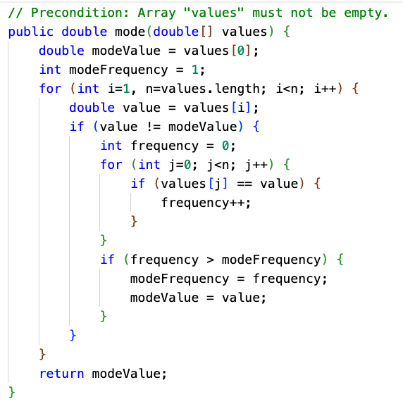
Mode
The running time of this algorithm is O(N²).
Good? Bad?

Slide 39
Mode
What if the array is sorted? Does that make it easier to calculate the mode?
1 | 1 | 2 | 2 | 2 | 3 | 3 | 3 | 3 | 4 | 4 | 5

Slide 40
Mode of sorted array
With a sorted array, all of the repeated elements are adjacent to each other.
We can avoid a nested loop.
We just need to loop once, and count how many occurrences there are of each element.
We still need to track the maximum frequency, and the value associated with it.
1 | 1 | 2 | 2 | 2 | 3 | 3 | 3 | 3 | 4 | 4 | 5

Slide 41
Mode of sorted array
This algorithm is a form of access all consecutive array elements.
We compare each element to the previous one to see how long the "runs" are.
1 | 1 | 2 | 2 | 2 | 3 | 3 | 3 | 3 | 4 | 4 | 5
frequency
1 | 2 | 1 | 2 | 3 | 1 | 2 | 3 | 4 | 1 | 2 | 1
modeValue
1 | 1 | 1 | 1 | 2 | 2 | 2 | 2 | 3 | 3 | 3 | 3
modeFrequency
1 | 2 | 2 | 2 | 3 | 3 | 3 | 3 | 4 | 4 | 4 | 4

Slide 42
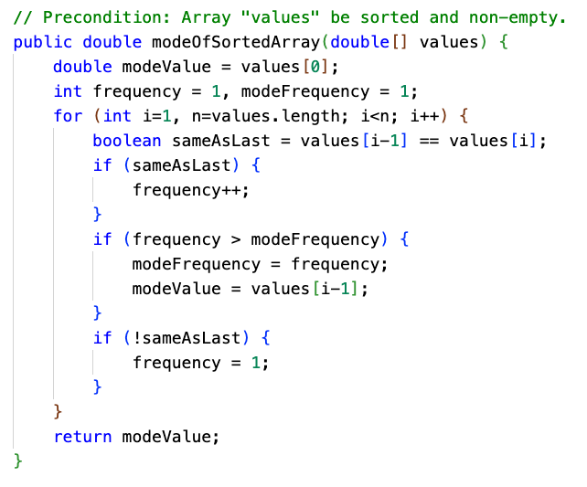
Mode of sorted array
Note how like calculating the minimum or maximum value, we can:
Seed the tracking variables with the first element in the array
And then, skip that element when iterating by starting the loop at i=1.
The running time of this algorithm is O(N).
But... the array must be sorted, and sorting takes O(N•log(N)).

Slide 43
6.4: Array Algorithms
part 2

Slide 44
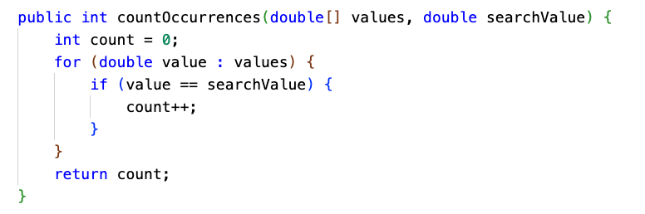
Determine number of elements meeting specific criteria

Slide 45
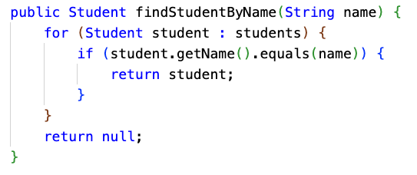
Search for a particular element in the array
This is known as linear search, the simplest (and least efficient) of search algorithms. We'll learn others later.

Slide 46
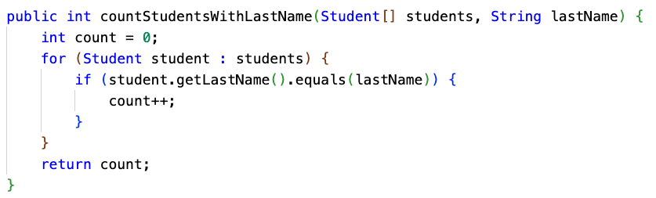
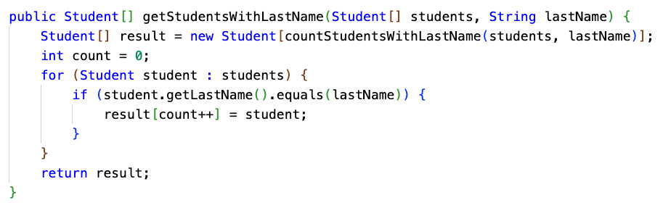
Filter an array for all matching elements
What if you want to find all matching elements? One way is to filter the array into a new array.
When returning an array that is a subset of the original array, you have to decide how big to make the result array.
Here, we do it by doing another pass through the array just to count how big the result array should be, using a helper method.
Another option would be the "growable array" pattern... In Unit 7, we'll cover ArrayList which could be used for this purpose.

Slide 47
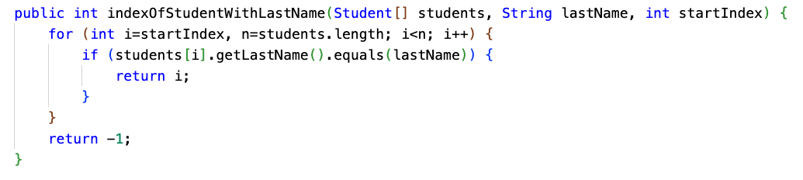
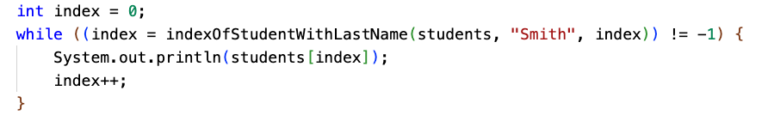
Search for all matching elements
Another way to find all matching elements is to build your own indexOf with startIndex parameter.

Slide 48
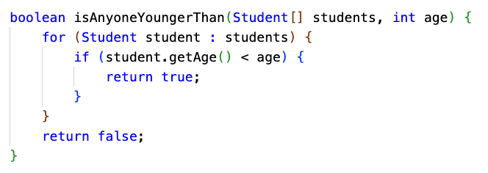
Determine if at least one element has a particular property
The output of this type of algorithm is a boolean. As soon as you find the first element with the desired property, you can return true.

Slide 49
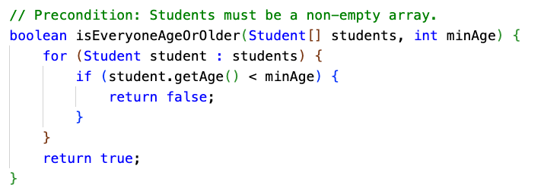
Determine if all elements have a particular property
This is essentially the same, except we're trying to ensure that ALL elements have some property. As soon as we find an element that doesn't, we return false.

Slide 50
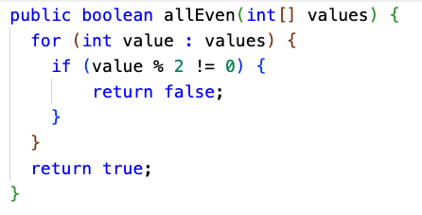
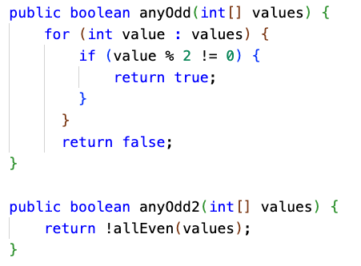
Universal / Existential Quantifiers
If all of the numbers all even, then there are no odd numbers.
If there are any odd numbers, then not all of the numbers are even.

Slide 51
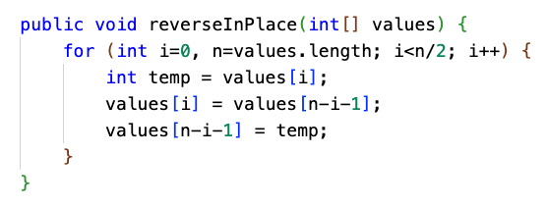
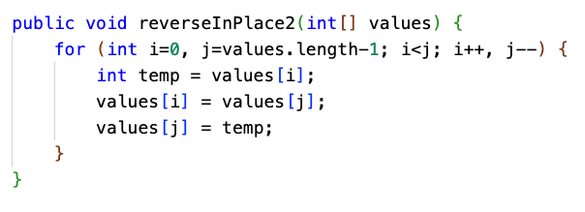
Reverse an array (in place)
The top implementation is fine, but the bottom one uses i and j instead of just i.
I find it easier to reason about what this algorithm is doing by having two index counters, "racing" toward each other from each end of the array.
Computers have many registers for storage of frequently used variables, so there is really no additional cost to having two variables instead of one. It can be even faster, since less arithmetic is performed.

Slide 52
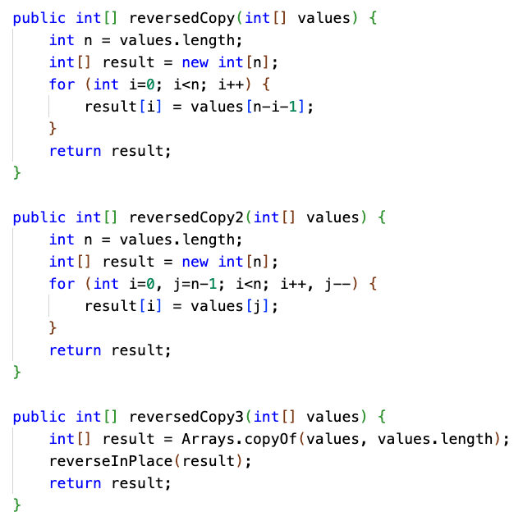
Return a reversed copy of an array
If you're returning a copy of an array in reverse order, you don't have to do any swapping.
It could still be helpful to use two counters instead of one.
You also could just not write the code at all... and leverage the reverse-in-place algorithm we just wrote. It will take a little more CPU time, though, since the array will first be copied, then reversed.

Slide 53
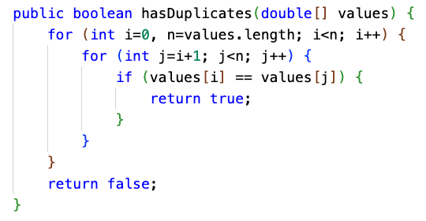
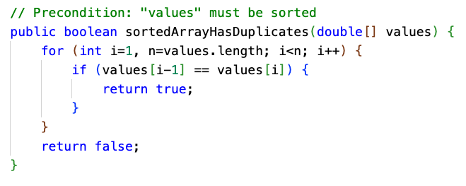
Check for presence of duplicate elements

Slide 54
Shift or rotate an array
Here, we rotate an array of numbers to the left by 1 position.
a[i] = a[i+1] for all i. The first element gets moved to the last position.
0 | 1 | 2 | 3 | 4 | 5 | 6 | 7 | 8 | 9 | 10 | 11
1 | 2 | 3 | 4 | 5 | 6 | 7 | 8 | 9 | 10 | 11 | 12
0 | 1 | 2 | 3 | 4 | 5 | 6 | 7 | 8 | 9 | 10 | 11
2 | 3 | 4 | 5 | 6 | 7 | 8 | 9 | 10 | 11 | 12 | 1

Slide 55
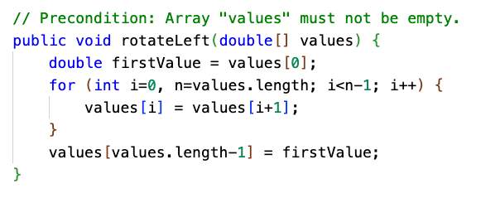
Rotate array to the left, in place
0 | 1 | 2 | 3 | 4 | 5 | 6 | 7 | 8 | 9 | 10 | 11
1 | 2 | 3 | 4 | 5 | 6 | 7 | 8 | 9 | 10 | 11 | 12
0 | 1 | 2 | 3 | 4 | 5 | 6 | 7 | 8 | 9 | 10 | 11
2 | 3 | 4 | 5 | 6 | 7 | 8 | 9 | 10 | 11 | 12 | 1

Slide 56
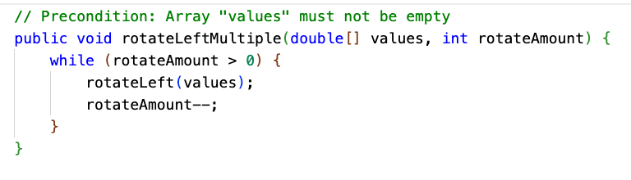
Rotate array to the left multiple positions, in place
There are other ways... but this is a quick and dirty way to do it.

Slide 57
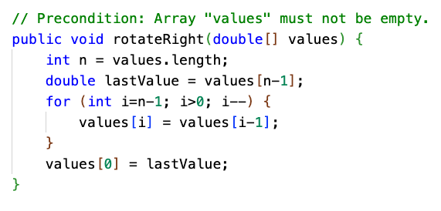
Rotate array to the right, in place
0 | 1 | 2 | 3 | 4 | 5 | 6 | 7 | 8 | 9 | 10 | 11
1 | 2 | 3 | 4 | 5 | 6 | 7 | 8 | 9 | 10 | 11 | 12
0 | 1 | 2 | 3 | 4 | 5 | 6 | 7 | 8 | 9 | 10 | 11
12 | 1 | 2 | 3 | 4 | 5 | 6 | 7 | 8 | 9 | 10 | 11

Slide 58
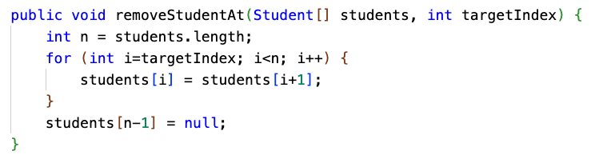
Remove element at specific index from an array
This is essentially like rotating left, but starting at a particular spot. Here, we fill in the end with null.

Slide 59
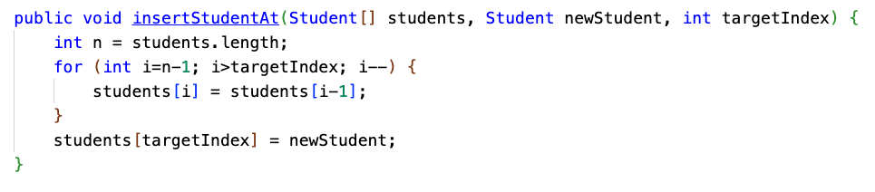
Insert element at specific index in array
This is very similar to rotating the array right, but starting at a specific index and not "wrapping."
The last element will be lost, so you'd have to make sure there is empty space at the end!

